Slide 1
Development of a ball-on-plate system
CONTEXT
Léa Beghin, Timothé Bigot, Emma Couston, Inès Naji, Maxime Oliveira Lopes, Lucie Vorms
Monday, May 27th
Tutors:
Elodie Chantery,
Sébastien Di Mercurio,
Gwendoline Le Corre
4AE-SE
Notes:
Inès
Hello everyone,
Thank you → showing up today → listen to this presentation.
We are → Léa → Timothé → Emma → Inès → Maxime → Lucie → and we will be → presenting → our research project → on → development of a ball-on-plate system

Slide 2
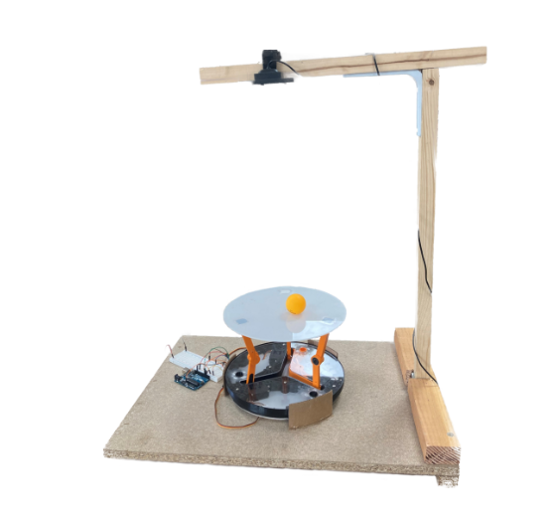
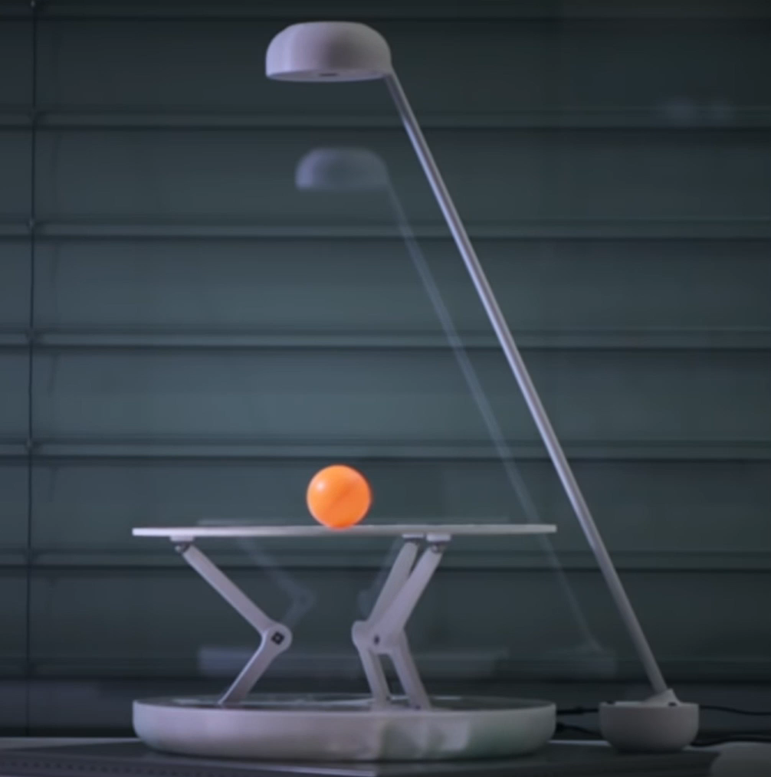

CONTEXT
OUR AIM
Widely studied
A lot of documentation
Multiple models
Complex control laws
Fig. 1: Example of a ball-on-plate system [1]
Maxime
Notes:
MAXIME
Let’s start by → putting → a bit of context.
--
The Ball-on-plate platform → well-known system → has been widely studied in the past → and → it has been → well documented by scientists around the world.
Stabilizing a ball on a plate → concrete and major objective in automation theory → that → relies on → fundamental notions.
Althought it might appear as → simple system → & → simple action, → it can be modeled → many ways → and → there exists → many types of control laws → to → control the system → some of them can be really challenging to implement.
Here → we will → considering → 3 DOF system → means → the plate can rotate on 2 axis → and → move up and down. We did not start from scratch → since → we took over → work initiated last year → by other students.

Slide 3
OUR AIM
OUTLINE
Robust control law + Good stability
Pratical work for students
Fig. 1: Example of a ball-on-plate system [1]
Fig. 2: Model of our system [2]
Maxime
Notes:
MAXIME
The main objective of this project → have a robust control law → to have → better closed loop reaction and a better performance → in order to → be able to keep the ball on the plate.
The final aim → have an efficient feedback of the actions being performed by the actuators on the computer → and be able to → control them in real-time → to provide → practical work session → for AE students. That way → they can apply automation concepts → concretely.
Last year, an Arduino microcontroller was used. This year, we switched to a Raspberry Pi 4 to fix communication issues and run the code entirely on Matlab. We also simulated the control law to measure its performance before implementing it on the real system.

Slide 4
OUTLINE
I – Description of the steps to achieve our goal
II – Simulation and experimental results
III – The next steps
Fig. 2: Model of our system [2]
Emma
Notes:
Here is the outline for our presentation:
First, we will describe the steps we took to achieve our goal.
Next, we will present our simulation and experimental results.
Finally, we will discuss the next steps in our project.

Slide 5
I – Description of the steps to achieve our goal
Understanding of previous work
Fig. 2: Model of our system [2]

Slide 6
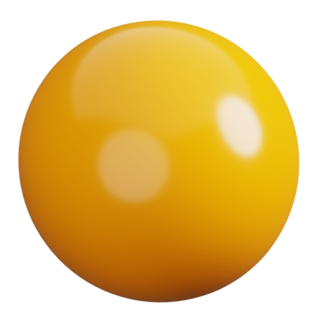
I – Description of the steps to achieve our goal
Identifying the problem
Understanding of previous work
Ball detection
Command of the 3 servomotors
TOO LONG DELAY
Fig. 2: Model of our system [2]
Léa
Notes:
First, let us describe the system we are talking about. Our model features a system with three degrees of freedom, consisting of a round plate managed by three servomotors. The ping pong ball is placed on this plate and a camera tracks its position. This camera is connected to an Arduino or Raspberry Pi 4 board, which is itself connected to a computer to relay commands to the servomotors.
When the ping pong ball is placed on the plate, the camera detects it and transmits the real-time image of the ball to the computer.
Then, the computer processes this image to determine the ball's position. A control algorithm (PID) sends instructions to the servomotors based on the ball's position calculated. The servomotors adjust accordingly to guide the ball to the center of the plate.

Slide 7

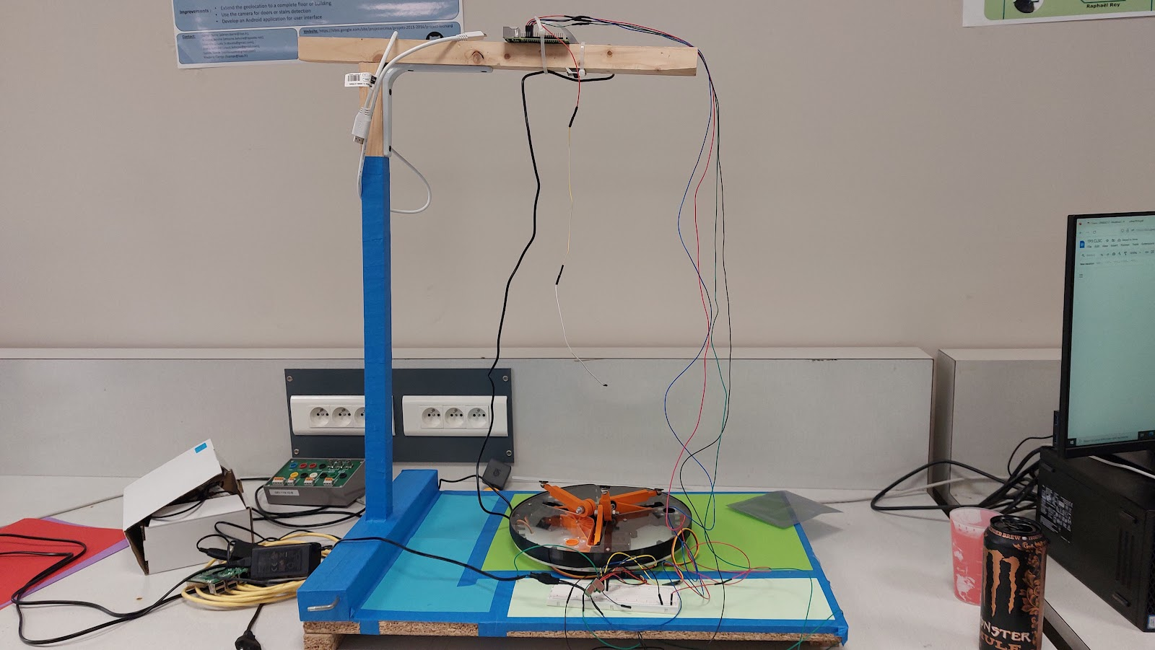
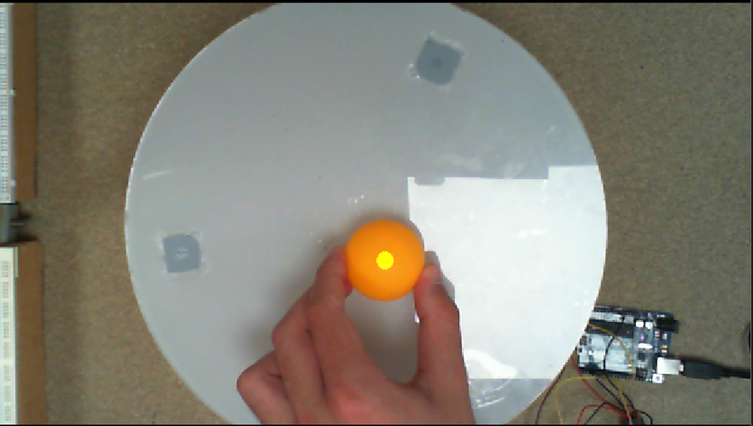
I – Description of the steps to achieve our goal
Understanding of previous work
Adapting the model
Figure 3: Allowable color range [3]
Figure 4: Sample image taken by the camera and processed [3]
Fig. 2: Model of our system [2]
Figure 5: Model of our system adapted
Inès
Notes:
The last group have incremented several parameters in order to identify the ball on the camera.
One of them was the allowable color range: In order to identify the ball, a wide range that takes into account different brightness conditions has been set.
However, when the ball was not in the camera frame, the algorithm tended to detect the support of the model as a ball because its color is similar to brown. This led to a brutal and non-logical reaction from the model because it acted as if the ball was on the plate.
For these reasons, we covered the support of the model with colored sheets, so that the support can not be detected as a ball.

Slide 8
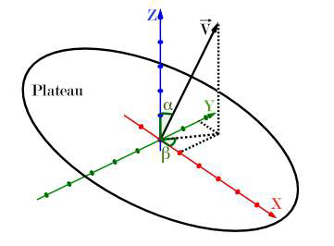
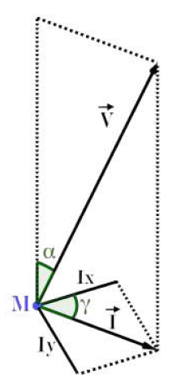
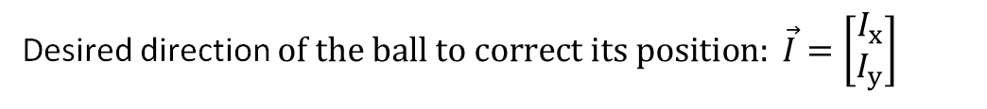
I – Description of the steps to achieve our goal
Adapting the model
Work on the Arduino
Desired direction $of the ball to correct its position: \vec{I}=\left[\begin{matrix}I_{x} \\ I_{y}\end{matrix}\right]$
Figure 6: Vector and angle representation [4]
Lucie
Figure 4: Sample image taken by the camera and processed [3]
Notes:
To vulgarize the geometrical problem let’s take an example
I vector : direction given from the point where is the ball to the center -> two components : Ix , Iy.
I talked about tilting the plate to give the right direction to ball, this inclination is of course represented by two angles: alpha and beta.
From I vector -> deduce : unit vector, perpendicular to the plate and whose origin corresponds to the center of the plate, in the figure it’s the V vector
𝛼 is the angle between the horizontal plane and the plane containing the plate
𝛽 defines the orientation of the plate.

Slide 9
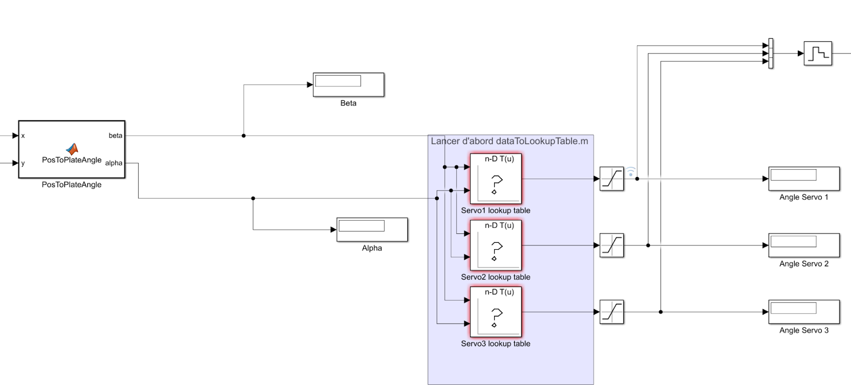
I – Description of the steps to achieve our goal
Adapting the model
Work on the Arduino
Desired direction $of the ball to correct its position: \vec{I}=\left[\begin{matrix}I_{x} \\ I_{y}\end{matrix}\right]$
Angle of the servomotors
Figure 6: Vector and angle representation [4]
𝛼 ≤ 35°
Figure 6: Extract of the Simulink done by the latest group on this project
Lucie
Notes:
Finally, the inclination of the plate is due to the angle of each servomotors.
So, once we have all of the information, we determine the angle of the servomotors thanks to a matrix of informations generated by an equation.
In addition, it is important to note that the model is only capable of tilting the plate a maximum of 35°.
Therefore 𝛼 must be inferior or equal to 35° and this condition must be applied in the Simulink model.

Slide 10
I – Description of the steps to achieve our goal
Adapting the model
Work on the Arduino
MISPLACED
Desired direction $of the ball to correct its position: \vec{I}=\left[\begin{matrix}I_{x} \\ I_{y}\end{matrix}\right]$
Angle of the servomotors
Figure 5: Vector and angle representation[4]
𝛼 ≤ 35°
Figure 7: Extract of the Simulink done by the latest group on this project
Lucie
Notes:
Now that I've explained the mathematical concepts, let's take a look at how it's applied on the model.
Once we ran the code, we detected some anomalies that seemed not to be linked with the delay. Indeed, only one of the three servomotors moved and the function which calculates the angle of the plate regularly generated an error.
Thanks to the display (where Alpha, Beta and Angle Servo 1, 2, 3 are indicated in figure x and x), we found that the servomotors were not moving because their angle values were too high in comparison to the saturation. First, we wondered if the saturation was too low or the computed angle was wrong. But after comparing the Simulink model with the theory, we realized that the saturation was applied to the wrong angle, it was on the servomotors’ angle instead of the plate’s angle (𝛼).

Slide 11
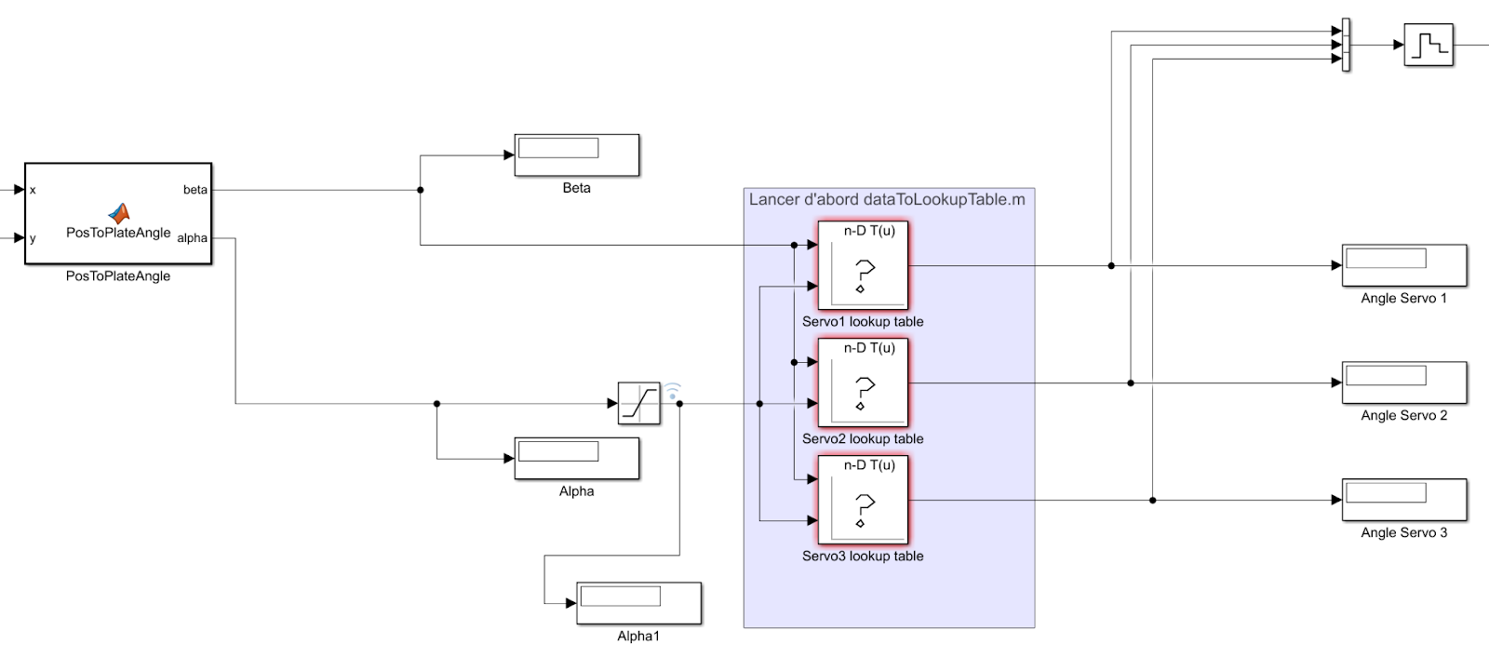
I – Description of the steps to achieve our goal
Adapting the model
Work on the Arduino
Desired direction $of the ball to correct its position: \vec{I}=\left[\begin{matrix}I_{x} \\ I_{y}\end{matrix}\right]$
Angle of the servomotors
Figure 5: Vector and angle representation
𝛼 ≤ 35°
Figure 8: Extract of the Simulink corrected with the saturation on the right angle (𝛼)
Lucie

Slide 12
I – Description of the steps to achieve our goal
Work on the Raspberry Pi card
Work on the Arduino
Desired direction $of the ball to correct its position: \vec{I}=\left[\begin{matrix}I_{x} \\ I_{y}\end{matrix}\right]$
𝛼 negative
Angle of the servomotors
Correction of the formulas
𝛼 positive
Figure 5: Vector and angle representation
𝛼 ≤ 35°
Figure 8: Extract of the Simulink corrected with the saturation on the right angle (𝛼)
Emma
Notes:
This was not the only error because once we corrected it, 𝛼 turned out negative. We took a closer look at the formulas implemented in the code which calculates 𝛼 and it was not geometrically correct.
Finally, after we corrected them, we obtained a satisfactory result despite the remaining delay. Manual movement of the ball over the plate generated a consistent response in terms of plate inclination. However, as the servomotor angle update times were too slow, the ball did not remain on the plate if we dropped it onto it.

Slide 13

I – Description of the steps to achieve our goal
Work on the Arduino
Work on the Raspberry Pi card
Desired direction $of the ball to correct its position: \vec{I}=\left[\begin{matrix}I_{x} \\ I_{y}\end{matrix}\right]$
USB port
More powerful processor
Less delay?
Maxime
𝛼 negative
Correction of the formulas
𝛼 positive
Figure 7: Extract of the Simulink corrected with the saturation on the right angle (𝛼)
Notes:
MAXIME
To solve the system slowness problems, we decided to use a Raspberry Pi 4 instead of an Arduino board.
The Raspberry Pi has a USB port for the webcam and a more powerful processor than the Arduino.
This means we won't need the computer as the main processing unit and interface for the actuators.
The image can be captured and processed directly on the Raspberry Pi, and it will update all actuators seamlessly.
This should greatly reduce the system response time and fix the slowness issue.

Slide 14

I – Description of the steps to achieve our goal
Work on the Arduino
Work on the Raspberry Pi card
Desired direction $of the ball to correct its position: \vec{I}=\left[\begin{matrix}I_{x} \\ I_{y}\end{matrix}\right]$
USB port
More powerful processor
Less delay?
Connection established
Connection problems
Test of the peripherals
Maxime
Notes:
MAXIME
First, we researched the Raspberry Pi to understand its functions.
We installed Raspbian OS designed specifically to work with MatLab and downloaded two packages on the PC to operate the Raspberry Pi via MatLab, using features like GPIO.
We faced connection issues between the board and MATLAB. Despite many attempts, the same error persisted.
We searched forums and reinstalled the OS and libraries several times, but without success. Trying to use Matlab Online did not solve the issue as well. In the end, we found that some necessary libraries were outdated and unavailable for download.
--
This was fixed this by getting our hand an older OS version with the right libraries installed. However, this troubleshooting helped us understand the board and its libraries better.
--
After connecting, we tested basic functions like toggling LEDs, setting up PWM signals. These tests confirmed that the peripherals worked, and we could control the servomotors with the Raspberry Pi.

Slide 15
I – Description of the steps to achieve our goal
Work on the Arduino
Work on the Raspberry Pi card
Adapt the Simulink blocks
Impossible to recover the image
Script the blocks in MATLAB
Inès
Notes:
INES
Next, we adapted the Simulink blocks for the Arduino board to work on the Raspberry Pi.
We had an issue with the USB camera from the previous group; Simulink couldn't detect it or process images. The issue persisted even after switching to the Raspberry Pi Camera.
To solve that issue, we decided to script our Simulink blocks in MATLAB, as its libraries had the necessary functions to capture and process images from the Raspberry Pi.

Slide 16
I – Description of the steps to achieve our goal
Work on the Arduino
Work on the Raspberry Pi card
Script the blocks in MATLAB
Creating the script
Structure the code
Laborious work: links between blocks
STILL TOO SLOW
Script
Configuration
Image acquisition and treatment
Control of the servomotors
Timothé
Notes:
The aim of this part was to rewrite the Simulink blocks in MATLAB code. The difficulty lay in sorting out the information from the blocks that were useful to us and finding the MATLAB code that had to be used. After creating the MATLAB script, we structured the code to make it easier to read and maintain.
This transfer work was quite laborious because we had to write the connection links between the blocks that were not materialized in Simulink. We also added the portions of code relating to the configuration of the card and the acquisition of the image taken by the camera. In addition, we wrote the function needed to control the servomotors, using the angles requested to calculate the duty cycle and then update the PWMs of each servomotor.
Once all the blocks had been transcribed, we tested our program on the system. Unfortunately, the system response time was still slow.

Slide 17
I – Description of the steps to achieve our goal
Work on the Arduino
Work on the Raspberry Pi card
Script the blocks in MATLAB
Creating the script
Structure the code
Laborious work: links between blocks
STILL TOO SLOW
Code in Python
Script
Configuration
Image acquisition and treatment
Control of the servomotors
MATLAB script + Python code from similar projects
Emma
Notes:
We needed to minimise this response time, so we chose to code our program in Python. As it offers a vast array of libraries and cross-platform compatibility, making it ideal for interfacing with hardware and developing embedded systems efficiently.
Since we already had our MATLAB code and could reference similar projects in Python, it was quicker and more efficient than converting Simulink blocks to MATLAB code. We systematically converted each MATLAB block into Python functions by comparing our MATLAB code with the Python code from similar projects.

Slide 18
I – Description of the steps to achieve our goal
Work on the Arduino
Work on the Raspberry Pi card
Code in Python
Attempts to run
Issues with OpenCV
PWMs not operational
Emma
Notes:
After converting all the main blocks, we tested those linked to physical objects, such as the camera and servomotors, on the Raspberry Pi 4.
The first issue we encountered was with OpenCV, the library we used for video processing. When attempting to capture a video, an error indicated that the system failed to allocate the necessary memory. This was unexpected, as the Raspberry Pi 4 typically has sufficient resources to handle basic video processing without memory allocation issues.
Next, we checked the PWM signals by examining the relevant pins with an oscilloscope. Seeing no activity, we performed a toggle operation on the same GPIO pin, to determine if the problem was specific to the PWMs. The successful toggle confirmed that the PWMs should have been operational.
​

Slide 19
II - Simulation and experimental results
PID Simulation with MATLAB

Slide 20
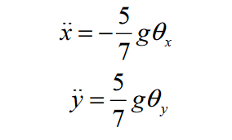
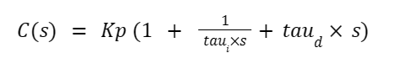
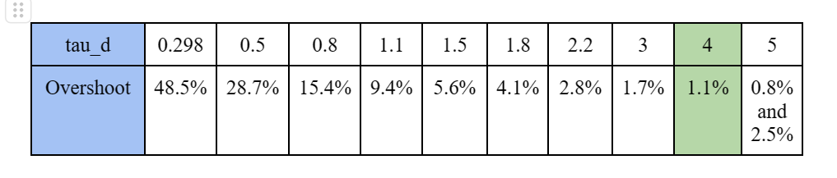
II - Simulation and experimental results
Simulation with the Raspberry Pi
PID Simulation with MATLAB
Transfer function of the system
Representation of the PID
Kp = 1.2
Tau_i = 1.1921
Tau_d = 4
Our results:
Inès
Notes:
In order to set the corrector, we wanted to simulate the system on Matlab.
First, we modelized our system. We regularly found in our sources the same simplification which leads to the same transfer function.
We first observed that without a control law, the system oscillates. By running several simulations, we set the parameters of the PID. However, there was still a significant overshoot. Therefore, we had to adjust the derivator. To do so, we simulated our model for different values. The results of these simulations are presented on this table.
We could then select the derivative component for which the overshsoot was the lowest.
We tested it in real life with the Arduino and it did not work at all. The plate behaved randomly. We then tried to remove the derivative component of the PID. The system worked as before, but the delay was still too long.

Slide 21
II - Simulation and experimental results
PID Simulation with MATLAB
Simulation with the Raspberry Pi
Have a better time response Identify + Move the code in the loop
Declarative Part
GPIO and variables/constant declaration One time only execution (about 4ms)
While loop
Real time calculus computing Regularly executed = time issue and optimisation to do
Timothé
21

Slide 22
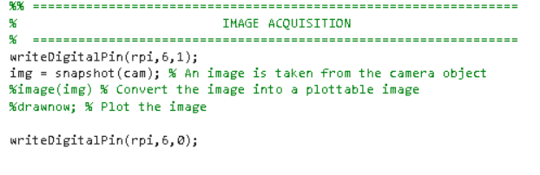
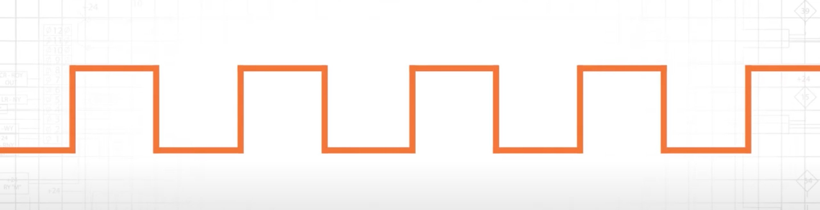
II - Simulation and experimental results
Simulation with the Raspberry Pi
t1
t1 t2 t3 t4
…....
Timothé

Slide 23
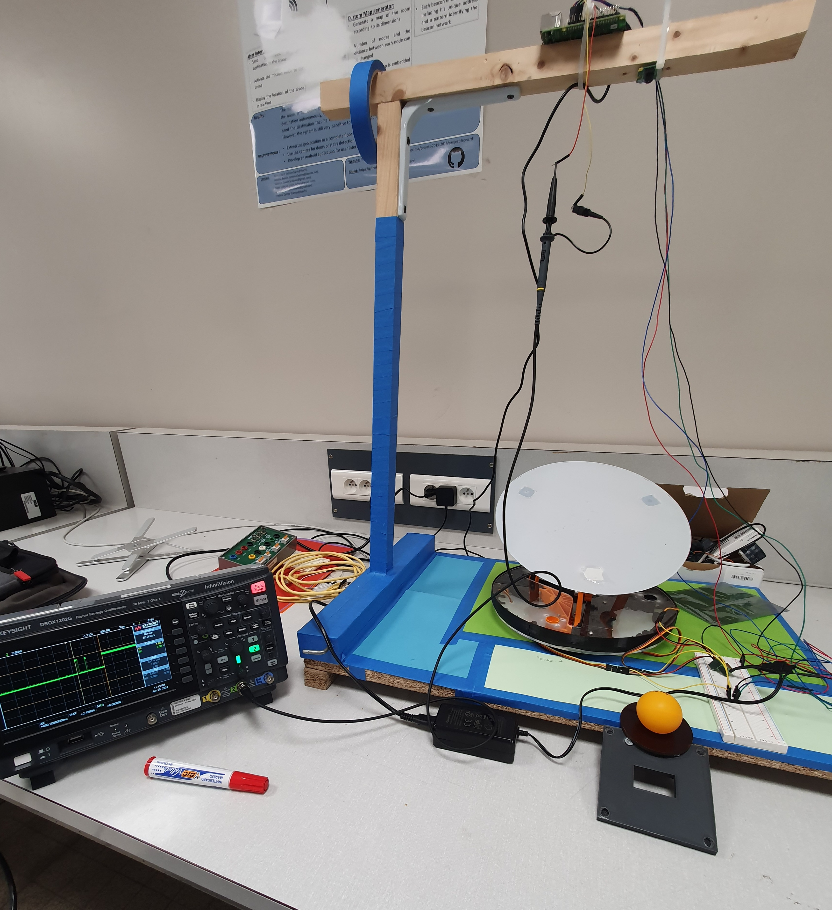
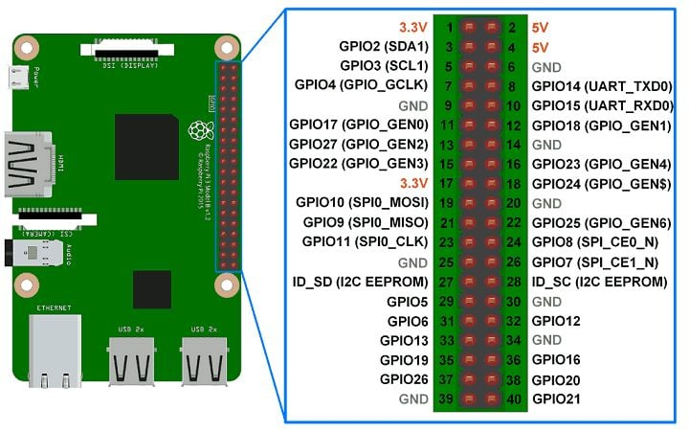
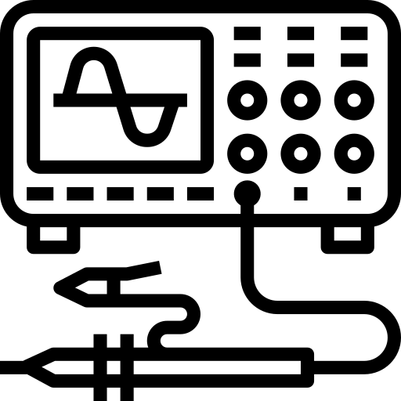
II - Simulation and experimental results
Simulation with the Raspberry Pi
=
+
Timothé

Slide 24
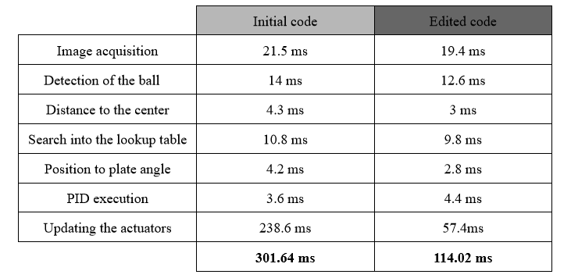
II - Simulation and experimental results
Simulation with the Raspberry Pi
Reduced by almost 3
Timothé

Slide 25
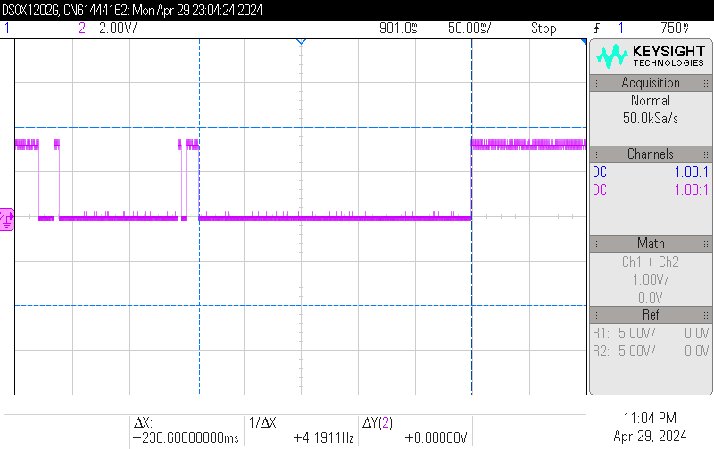
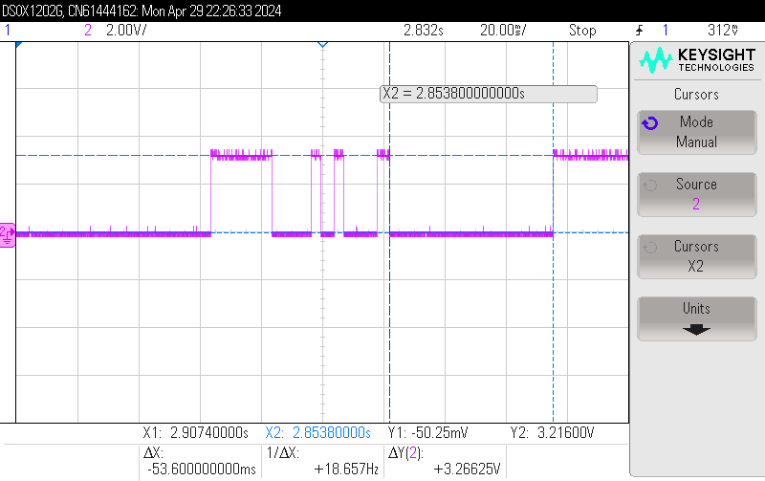
II - Simulation and experimental results
Simulation with the Raspberry Pi
Initial Time Response Optimised Time Response
Timothé

Slide 26
III – The next steps

Slide 27
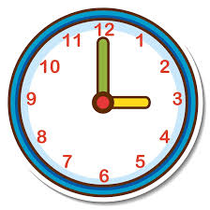

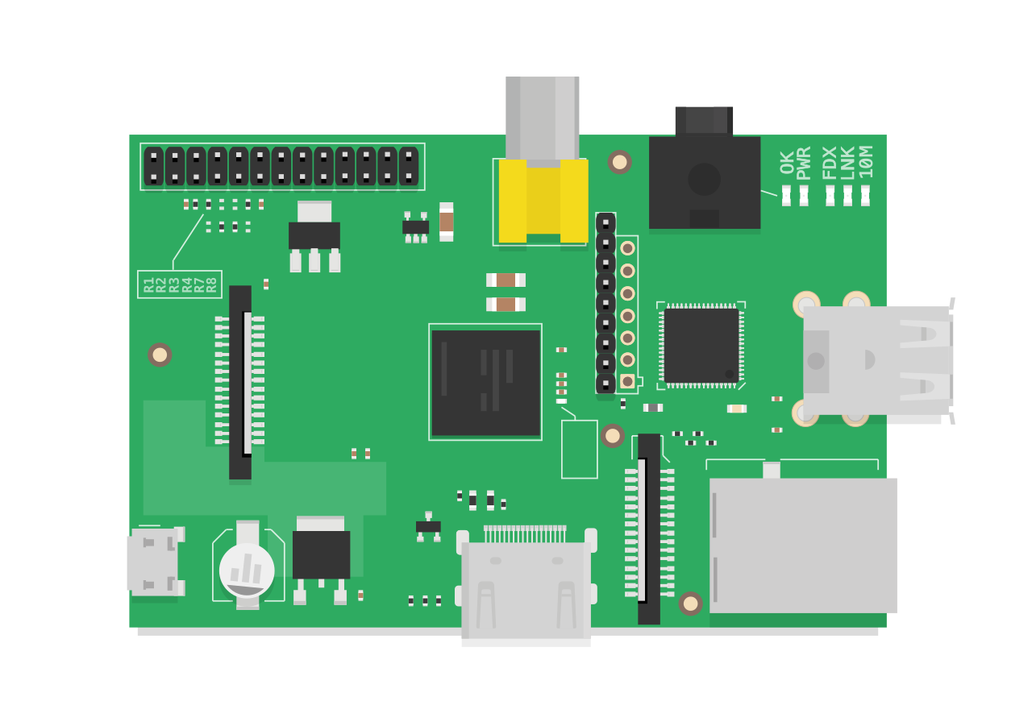
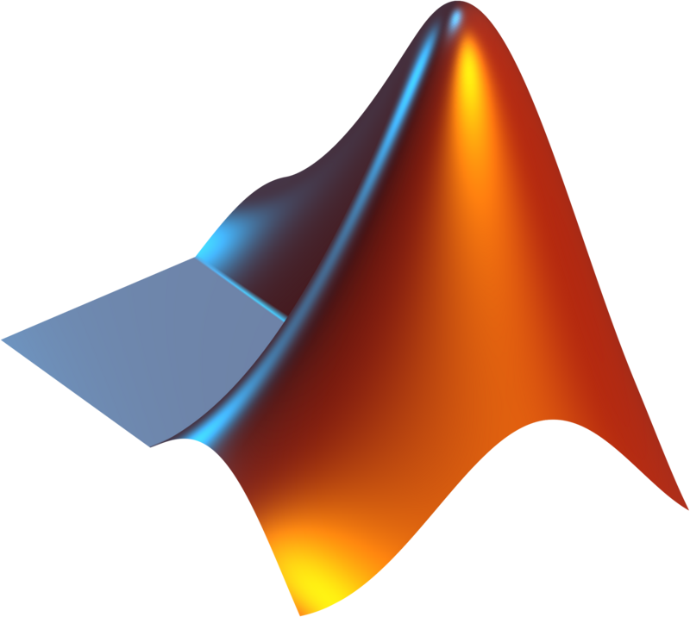
III – The next steps
1. Try with another library
- library rpi.gpio
2. Change our Raspberry Pi 4 card
- Memory allocation problem
- Test the PWMs
3. Implementation of the Python code
- Test on the system
- Measurement of the response time
4. Resolve MATLAB problems
- Reduce execution time
Léa
Notes:
Unfortunately, we did not have enough time to resolve the issues related to implementing the Python code on the board. However, we have several ideas for addressing these errors.
Firstly, we used the rpi.gpio library to code our scripts in Python. This library includes functions for initializing peripherals. Therefore, the PWMs were tested with this librairy. In that way, one potential solution would be to test the PWMs with another library to determine if the source of the problem is linked to this one.
Secondly, Mr. Di Mercurio had successfully tested PWMs with his own board. However, we were unable to connect to his board to examine the code and the libraries he used. On the other hand, we think that switching boards could help determine whether the memory allocation issue is specific to our card or if it is related to this model in general.
Then, once the Python code is operational, the goal would be to implement it on the board and run our system to evaluate its performance. If a faster response time is achieved, it would then be needed to adjust the PID to control the angle of the servomotors.
Finally, it might be beneficial to find a way to reduce the execution time of the MATLAB code. Although we managed to cut it by a third, the system is still too slow.

Slide 28
Conclusion

Slide 29

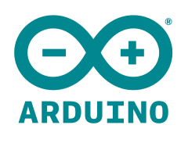

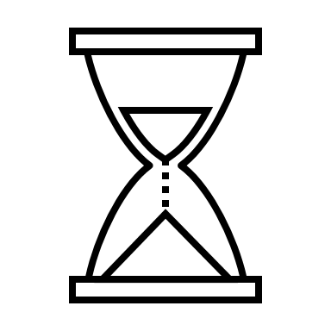
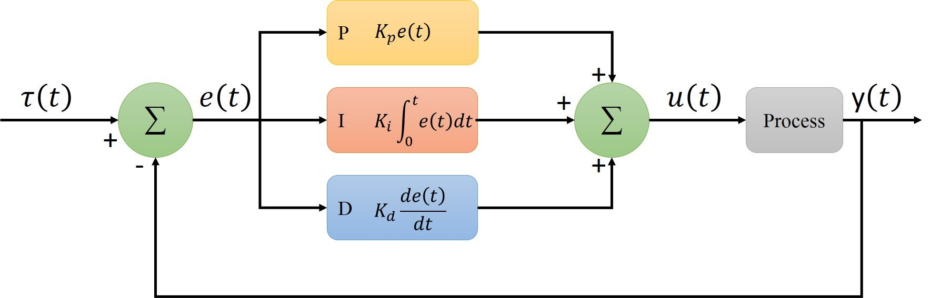
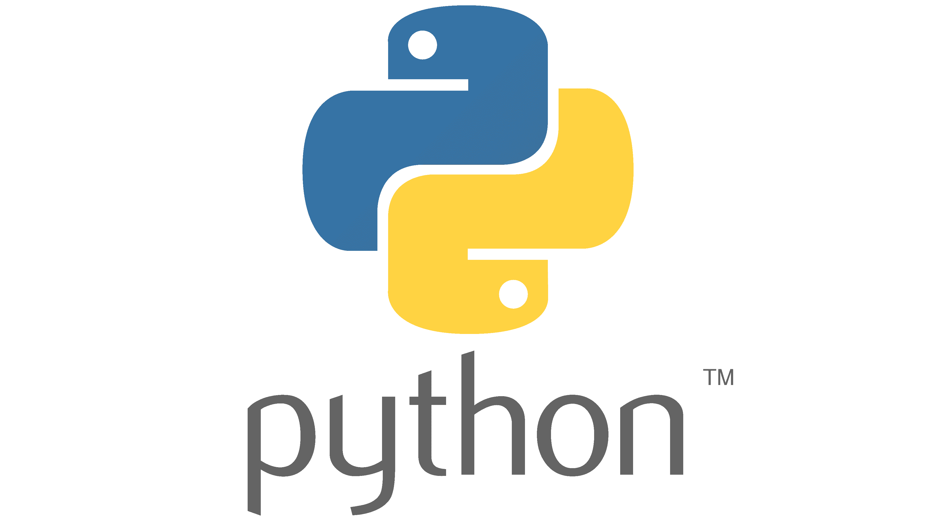
Conclusion
REFERENCES
Hardware
Software
Objectives
Resolving the delay issue
PID tuning
Lucie

Slide 30
REFERENCES
[1] J. Link, 'Ball Balancing PID System,' YouTube, 24-Dec-2018. [Online]. Available: https://www.youtube.com/watch?v=57DbEEBF7sE. [Accessed: Mar. 20, 2024].
[2] « Cours: I4IRPJ11, I4AEPJ11, I4ISPJ11 : Projet d’Initiation à la Recherche | Moodle ». Available: https://moodle.insa-toulouse.fr/course/view.php?id=1207. [Accessed: Feb. 25, 2024]
[3] ‘PIR_Ball_Balancing/Report/Report_PIR_ae09_p03.pdf at main · TacTac315/PIR_Ball_Balancing’. Available: https://github.com/TacTac315/PIR_Ball_Balancing/blob/main/Report/Report_PIR_ae09_p03.pdf. [Accessed: May 18, 2024]
[4] Link, Johan, « Ball-Balancing-PID-System/TM_SJF_version.pdf at master JohanLink/Ball-Balancing-PID-System », GitHub. Available: https://github.com/JohanLink/Ball-Balancing-PID-System/blob/master/TM_SJF_version.pdf. [Accessed: Dec. 9, 2023]

